Slide 1
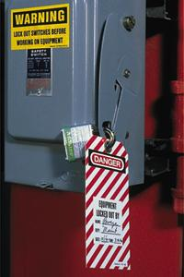
1910.147
The Control of
Hazardous Energy
Lockout/Tagout

Slide 2
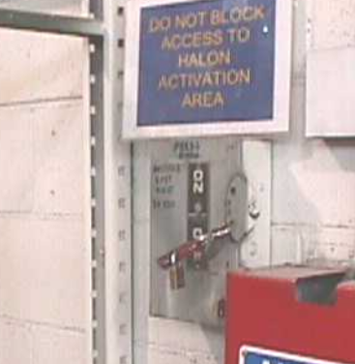
1910.147(a)(1) Scope
This standard covers the servicing and maintenance of machines and equipment in which the "unexpected" energization or start up of the machines or equipment, or release of stored energy could cause injury to employees.

Slide 3


1910(a)(1)(ii) Exemptions
Construction, agriculture and maritime employment;
Electrical Utilities;
Exposure to electrical hazards from work on, near, or with conductors or equipment in electric utilization installations, which is covered by Subpart S of this part; and
Oil and gas well drilling and servicing

Slide 4
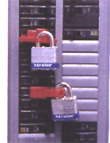
1910.147(a)(3) Purpose
Establish a program and utilize procedures for affixing appropriate lockout devices or tagout devices to energy isolating devices
Prevent unexpected energization, start up or release of stored energy in order to prevent injury to employees

Slide 5

1910.147(c) General Requirements
The employer shall establish a program consisting of:
  Energy control procedures,
  Employee training and,
  Periodic inspections
To ensure that before any employee performs any servicing or maintenance on a machine or equipment where the unexpected energizing, startup or release of stored energy could occur and cause injury, the machine or equipment shall be isolated from the energy source and rendered inoperative.

Slide 6

1910.147(c)(4) General Requirements
"Energy control procedure.”
Procedures shall be developed, documented and utilized for the control of potentially hazardous energy when employees are engaged in the activities covered by this section.

Slide 7
Note: "Exception:" The employer need not document the required procedure for a particular machine or equipment, when all (8) of the following elements exist:
[1] The machine or equipment has no potential for stored or residual energy or reaccumulation of stored energy after shut down which could endanger employees
[2] the machine or equipment has a single energy source which can be readily identified and isolated
[3] the isolation and locking out of that energy source will completely deenergize and deactivate the machine or equipment
[4] the machine or equipment is isolated from that energy source and locked out during servicing or maintenance

Slide 8
Note: "Exception:" (continued) when all of the following elements exist:
[5] a single lockout device will achieve a lock-out condition
[6] the lockout device is under the exclusive control of the authorized employee performing the servicing or maintenance
[7] the servicing or maintenance does not create hazards for other employees; and
[8] the employer, in utilizing this exception, has had no accidents involving the unexpected activation or reenergization of the machine or equipment during servicing or maintenance

Slide 9

1910.147(c)(4) General Requirements - Energy Control Procedure
The procedures shall clearly and specifically outline the:
  Scope,
  Purpose,
  Authorization,
  Rules, and
  Techniques to be utilized for the control of hazardous energy, and the means to enforce compliance including, but not limited to, the following:

Slide 10

Energy Control Procedures
A specific statement of the intended use of the procedure;
Specific procedural steps for shutting down, isolating, blocking and securing machines or equipment to control hazardous energy;

Slide 11

Energy Control Procedure
Specific procedural steps for the placement, removal and transfer of lockout devices or tagout devices and the responsibility for them; and
Specific requirements for testing a machine or equipment to determine and verify the effectiveness of lockout devices, tagout devices, and other energy control measures

Slide 12
Standard Interpretations
11/16/2000 - Applicability of OSHA's LOTO standards; isolation and verification procedures
As you seem to recognize, there are two standards that are most directly applicable to the circumstance described in your letter: 29 CFR 1910.147, The control of hazardous energy (lockout/tagout), and 29 CFR 1910.333, Selection and use of safe work practices.
Section 1910.147 covers the servicing and maintenance of machines and equipment in which uncontrolled hazardous energy could cause injury to employees.
Section 1910.333(b) provides procedures to protect employees who are working on or near exposed de-energized electric parts.

Slide 13
Standard Interpretations
11/16/2000 - Applicability of OSHA's LOTO standards; isolation and verification procedures
Both standards mandate the use of locks and/or tags to control potentially hazardous energy.¹
Footnote(1) Lockout and tagging procedures that comply with paragraphs (c) through (f) of §1910.147 constitute compliance with §1910.333(b)(2), as long as the procedures address the electrical safety hazards covered by Subpart S and incorporate the requirements of §1910.333(b)(2)(iii)(D) and (iv)(B).

Slide 14
Standard Interpretations
11/16/2000 - Applicability of OSHA's LOTO standards; isolation and verification procedures
Whether the authorized or qualified employee verifies effective isolation and de-energization depends upon the energy source.
For example, an electric disconnect switch may control a mechanical or an electrical energy hazard, or both, depending on the electrical system design and the nature of the work tasks involved.

Slide 15
Standard Interpretations
11/16/2000 - Applicability of OSHA's LOTO standards; isolation and verification procedures
With respect to employees working on or near de-energized electrical utilization systems (covered by Subpart S, Electrical, standards), both the authorized employee and the qualified employee are permitted to verify that electrical equipment has been de-energized.
However, the authorized employee would need to meet and be trained on all qualified employee requirements in 1910.331 through 1910.335 and 1910.399.

Slide 16
Standard Interpretations
11/16/2000 - Applicability of OSHA's LOTO standards; isolation and verification procedures
The verification of isolation for mechanical hazardous energy, on the other hand, is addressed by paragraph 1910.147(d)(6).
The authorized employee(s) must, prior to the start of work, verify that the previous steps of the energy control procedure have effectively isolated the machine or equipment.

Slide 17
Standard Interpretations
11/16/2000 - Applicability of OSHA's LOTO standards; isolation and verification procedures
These steps must include verification that the machine or equipment has been turned off properly;
  That all energy isolating devices were identified, located, and operated;
  That the lockout or tagout devices (or application of a lock and tag for electrical control purposes) have been attached to energy isolating devices; and
  That stored energy has been released, discharged, and rendered safe.

Slide 18
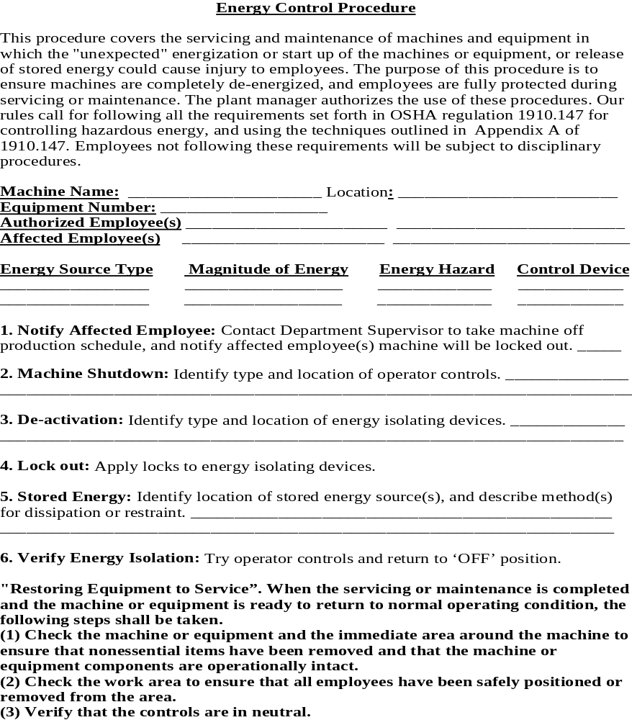
S
A
M
P
L
E
P
R
O
C
E
D
U
R
E

Slide 19

1910.147(c)(6) Periodic Inspection
The employer shall conduct a periodic inspection of the energy control procedure at least annually to ensure that the procedure and the requirements of this standard are being followed

Slide 20

1910.147(c)(6) Periodic Inspection
(A) The periodic inspection shall be performed by an authorized employee other than the one(s) utilizing the energy control procedure being inspected
(B) The periodic inspection shall be conducted to correct any deviations or inadequacies identified

Slide 21

1910.147(c)(6)(i)(C) Periodic Inspection
The periodic inspection shall include a review, between the inspector and each authorized employee, of that employee's responsibilities under the energy control procedure being inspected

Slide 22
1910.147 (c)(6)(ii) Periodic Inspection
The employer shall certify that the periodic inspections have been performed.
The certification shall identify:
  The machine or equipment on which the energy control procedure was being utilized,
  The date of the inspection,
  The employees included in the inspection, and
  The person performing the inspection.

Slide 23
Standard Interpretations
07/31/1991 - Confirmation on lockout/tagout, specifically with the standard covering periodic inspections
These inspections shall at least provide for a demonstration of the procedures and may be implemented through random audits and planned visual observations.
These inspections are intended to ensure that the energy control procedures are being properly implemented and to provide an essential check on the continued utilization of the procedures.

Slide 24
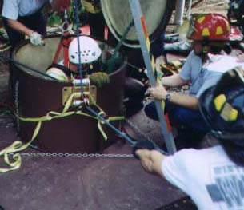
Permit Required
Confined Spaces
CFR 1910.146

Slide 25

1910.146(a) Scope
Requirements for practices and procedures to protect employees in general industry from the hazards of entry into permit-required confined spaces
Does not apply to:
  Agriculture,
  Construction,
  Shipyard employment

Slide 26
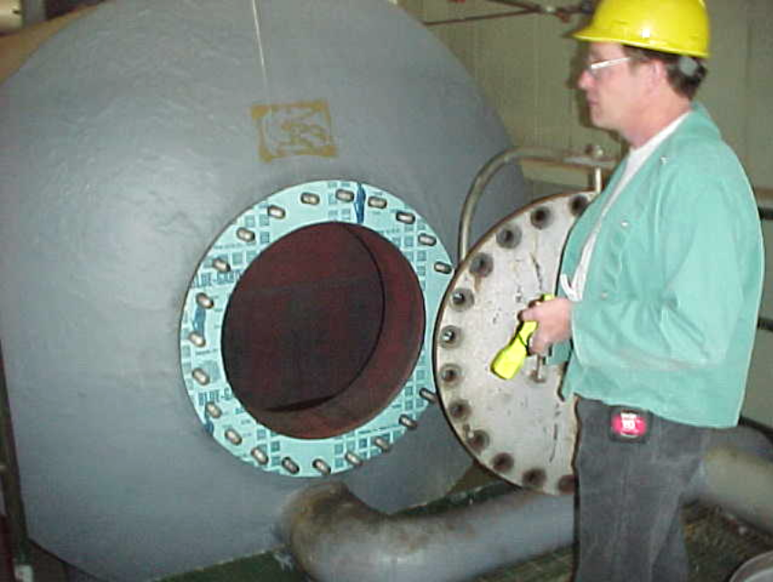
1910.146(b) Definitions
"Confined space" means a space that:
  (1) Is large enough to enter and perform work
  (2) Has limited or restricted means for entry or exit
  (3) Is not designed for continuous employee occupancy

Slide 27

1910.146(b) Definitions
"Permit-required confined space (permit space)" means a confined space that has one or more of the following characteristics:
  a. Contains or has a known potential to contain a hazardous atmosphere;
  b. Contains a material with the potential for engulfment of the entrant;
  c. Has an internal configuration such that an entrant could be trapped or asphyxiated by inwardly converging walls or a floor which slopes downward and tapers to a smaller cross-section;
  d. Contains any other recognized safety or health hazard

Slide 28
1910.146(c)(2) General Requirements
Evaluate the workplace to determine if any spaces are permit-required confined spaces
If the workplace contains permit spaces, inform employees by posting danger signs* of the location and danger posed by the permit spaces
Or by other equally effective means (i.e. training affected employees)
*NOTE: A sign reading DANGER -- PERMIT-REQUIRED CONFINED SPACE, DO NOT ENTER or using other similar language would satisfy the requirement for a sign.

Slide 29
Standard Interpretations
12/20/1994 - Answers to specific questions concerning the permit-required confined spaces standard
The General requirements paragraph 1910.146(c)(1) requires that all employers in General Industry evaluate their workplace to determine if any permit-required confined spaces [permit space(s)] exist.
In order to make a permit space determination, all spaces fitting the definition of a confined space must be identified.

Slide 30
Standard Interpretations
12/20/1994 - Answers to specific questions concerning the permit-required confined spaces standard
The standard does not require a listing of confined spaces or permit spaces; however, a prudent employer would memorialize both classes of spaces, because the standard's requirement to identify permit spaces is ongoing.

Slide 31

1910.146(c)(4) General Requirements
If the employer decides that its employees will enter permit spaces, must develop and implement a written permit space program
The written program available for inspection by employees and their authorized representatives

Slide 32
1910.146(c)(5) General Requirements
An employer may use alternate procedures for entering a permit space, provided that:
  The only hazard posed by the permit space is an actual or potential hazardous atmosphere;
  Continuous forced air ventilation alone is sufficient to maintain that permit space safe for entry;
  The employer develops monitoring and inspection data that supports the above two points, documents the supporting data, and makes it available to each employee who enters the permit space
Then the employer does not need a permit, an attendant, rescue or emergency equipment

Slide 33
Standard Interpretations
05/10/1993 - Clarification of paragraphs (c)(5) and (c)(7) of the Permit-Required Confined Spaces standard
  There is a permit space open-top mixer in which cleaning chemicals are manufactured.
  Fresh air can be forced into the precleaned mixer to control any atmospheric hazards and the off-on switch can be locked out to eliminate the hazard created by the mixing blades.

Slide 34
Standard Interpretations
05/10/1993 - Clarification of paragraphs (c)(5) and (c)(7) of the Permit-Required Confined Spaces standard
For the condition described above, the procedures set forth in paragraph (c)(5)(ii) would be the appropriate procedures to be followed, but only after all the conditions required by paragraph (c)(5)(i) have been met.
The reclassification from permit-required to non-permit allowed by paragraph (c)(7) is only for those PRCS which pose no actual or potential atmospheric hazards.

Slide 35
Standard Interpretations
05/10/1993 - Clarification of paragraphs (c)(5) and (c)(7) of the Permit-Required Confined Spaces standard
Control of atmospheric hazard through forced air ventilation does not constitute elimination of the hazards.
Paragraph (c)(5) covers permit space entry where the employer can demonstrate that forced ventilation alone will control all hazards in the space.

Slide 36
1910.146 (c)(7)(i) Reclassification of a permit space
If the permit space poses no actual or potential atmospheric hazards and if all hazards within the space are eliminated without entry into the space, the permit space may be reclassified as a non-permit confined space for as long as the non-atmospheric hazards remain eliminated.
Employer certification of the elimination of the hazards required

Slide 37

1910.146(c)(8) Contractors
Host employers must inform contractors:
Apprise the contractor of the hazards identified
Apprise the contractor of any precautions or procedures
Coordinate entry operations with the contractor

Slide 38

1910.146(d) Permit program requirements:
Develop and implement procedures:
  Acceptable entry conditions;
  Isolating the permit space;
  Purging, inerting, flushing, or ventilating the permit space as necessary
  Providing pedestrian, vehicle, or other barriers

Slide 39

1910.146(d) Permit program requirements:
Designate the persons who are to have active roles:
  Authorized entrants,
  Attendants, entry supervisors,
  Persons who test or monitor the atmosphere
Identify the duties of each such employee, and provide each such employee with the training required by paragraph (g)

Slide 40

1910.146(d) Permit program requirements:
Develop and implement procedures for summoning rescue and emergency services,
For rescuing entrants from permit spaces,
For providing necessary emergency services to rescued employees, and;
For preventing unauthorized personnel from attempting a rescue;

Slide 41

1910.146(e) Permit System
Before entry is authorized, the employer must prepare an entry permit
Appendix D to section 1910.146 presents examples of permits
Entry Permit

Slide 42
1910.146(g) Training
Training shall be provided to each affected employee:
  Before the employee is first assigned duties under this section;
  Before there is a change in assigned duties;
Permit Entry:
  Hazards
  Equipment
  Skills

Slide 43

1910.146(g) Training
Employer must certify that the training has been accomplished
Certification contains:
  Each employee's name,
  The signatures or initials of the trainers, and
  The dates of training
Certification available for inspection by employees and their authorized representatives
fined Space

Slide 44
Standard Interpretations
12/20/1994 - Answers to specific questions concerning the permit-required confined spaces standard
The PRCS standard's requirement for providing training places the obligation on the employer of the employee who will be entering the permit space.
With regard to rescue, if the host employer (site employer) chooses to have their own rescue service, then the host employer is required to provide all the training.

Slide 45
Standard Interpretations
12/20/1994 - Answers to specific questions concerning the permit-required confined spaces standard
When the host employer arranges for rescue services by personnel other than his or her employees, then the obligation for providing the rescue-related training is placed on the employer of the arranged-for rescue service.

Slide 46
Standard Interpretations
12/20/1994 - Answers to specific questions concerning the permit-required confined spaces standard
Since the host employers possess exclusive knowledge and understanding of their permit space(s), such as inherent and unique hazards of the spaces and work practices associated with the permit space, they are obligated under 1910.146(c)(8) to provide this exclusive knowledge to all contractors entering the permit space, including the arranged-for rescue service.
Thus the requirement for authorized entrant training for rescue services responders specified in 1910.146(k)(1)(ii) must be provided by the host employer.

